Slide 1
Lecture 10 Looping

Slide 2
Loops:
Loops are used to repeat a block of code.
Loops causes program to execute the certain block of code repeatedly until some conditions are satisfied.
That is loops are used in performing repetitive work in programming.
For example : Suppose you want to execute some code/s 10 times. You can perform it by writing that code/s only one time and repeat the execution 10 times using loop.

Slide 3
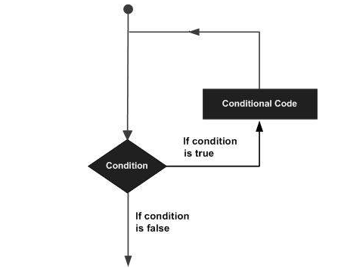
A loop statement allows us to execute a statement or group of statements multiple times and following is the general form of a loop statement in most of the programming languages:

Slide 4
Types of Loops:
C programming language provides the following types of loop to handle looping requirements.
Loop Type | Description
while loop | Repeats a statement or group of statements while a given condition is true. It tests the condition before executing the loop body.
for loop | Execute a sequence of statements multiple times and abbreviates the code that manages the loop variable.
do...while loop | Like a while statement, except that it tests the condition at the end of the loop body
nested loops | You can use one or more loop inside any another while, for or do..while loop.

Slide 5
Syntax of while loop
while (test expression)
{
statement/s to be executed.
}
Loops has four parts :
Declaration
Initialization
Condition
Increment/Decrement.

Slide 6
The while loop checks whether the test expression is true or not.
If it is true, code/s inside the body of while loop is executed, that is, code/s inside the braces { } are executed.
Then again the test expression is checked whether test expression is true or not.
This process continues until the test expression becomes false.

Slide 7
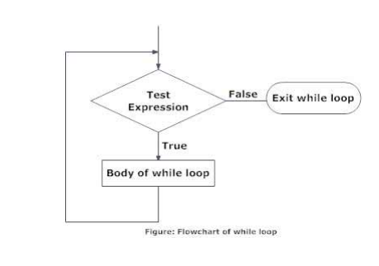
Flow Chart of While loop

Slide 8
Let us consider an example:
Print all numbers from 1 -100.
#include<stdio.h>
int main()
{
int i;
i=1;
while (i<=100)
{
printf(“%d\n”,i);
i=i+1;
}
return 0;
}

Slide 9
Let us consider another example:
Print all even numbers from 500 to 1000.
#include<stdio.h>
int main()
{
int i;
i=500;
while (i<=1000)
{
printf(“%d\n”,i);
i=i+2;
}
return 0;
}

